Slide 1
SESIÓN 1
Sesión 1: Riesgo de Cibersegurdad
− Video Introductorio
− Casos de Estudio:
Caso Target
Caso Sony
Caso Ashley Madison
Presentación Ciberseguridad vs seguridad de la información
Session 1: Cyber Security Risk
- Introductory video
- Case studies. Presentations:
- Target
- Sony
- Ashley Madison
- Presentation: Cyber Security versus Information Security

Slide 2

The most valuable commodity I know of is information…
Gordon Gekko (Michael Douglas) - Wall Street - 1987
https://www.youtube.com/watch?v=7UPe_fxOz8M

Slide 3
CASOS CASES

Slide 4
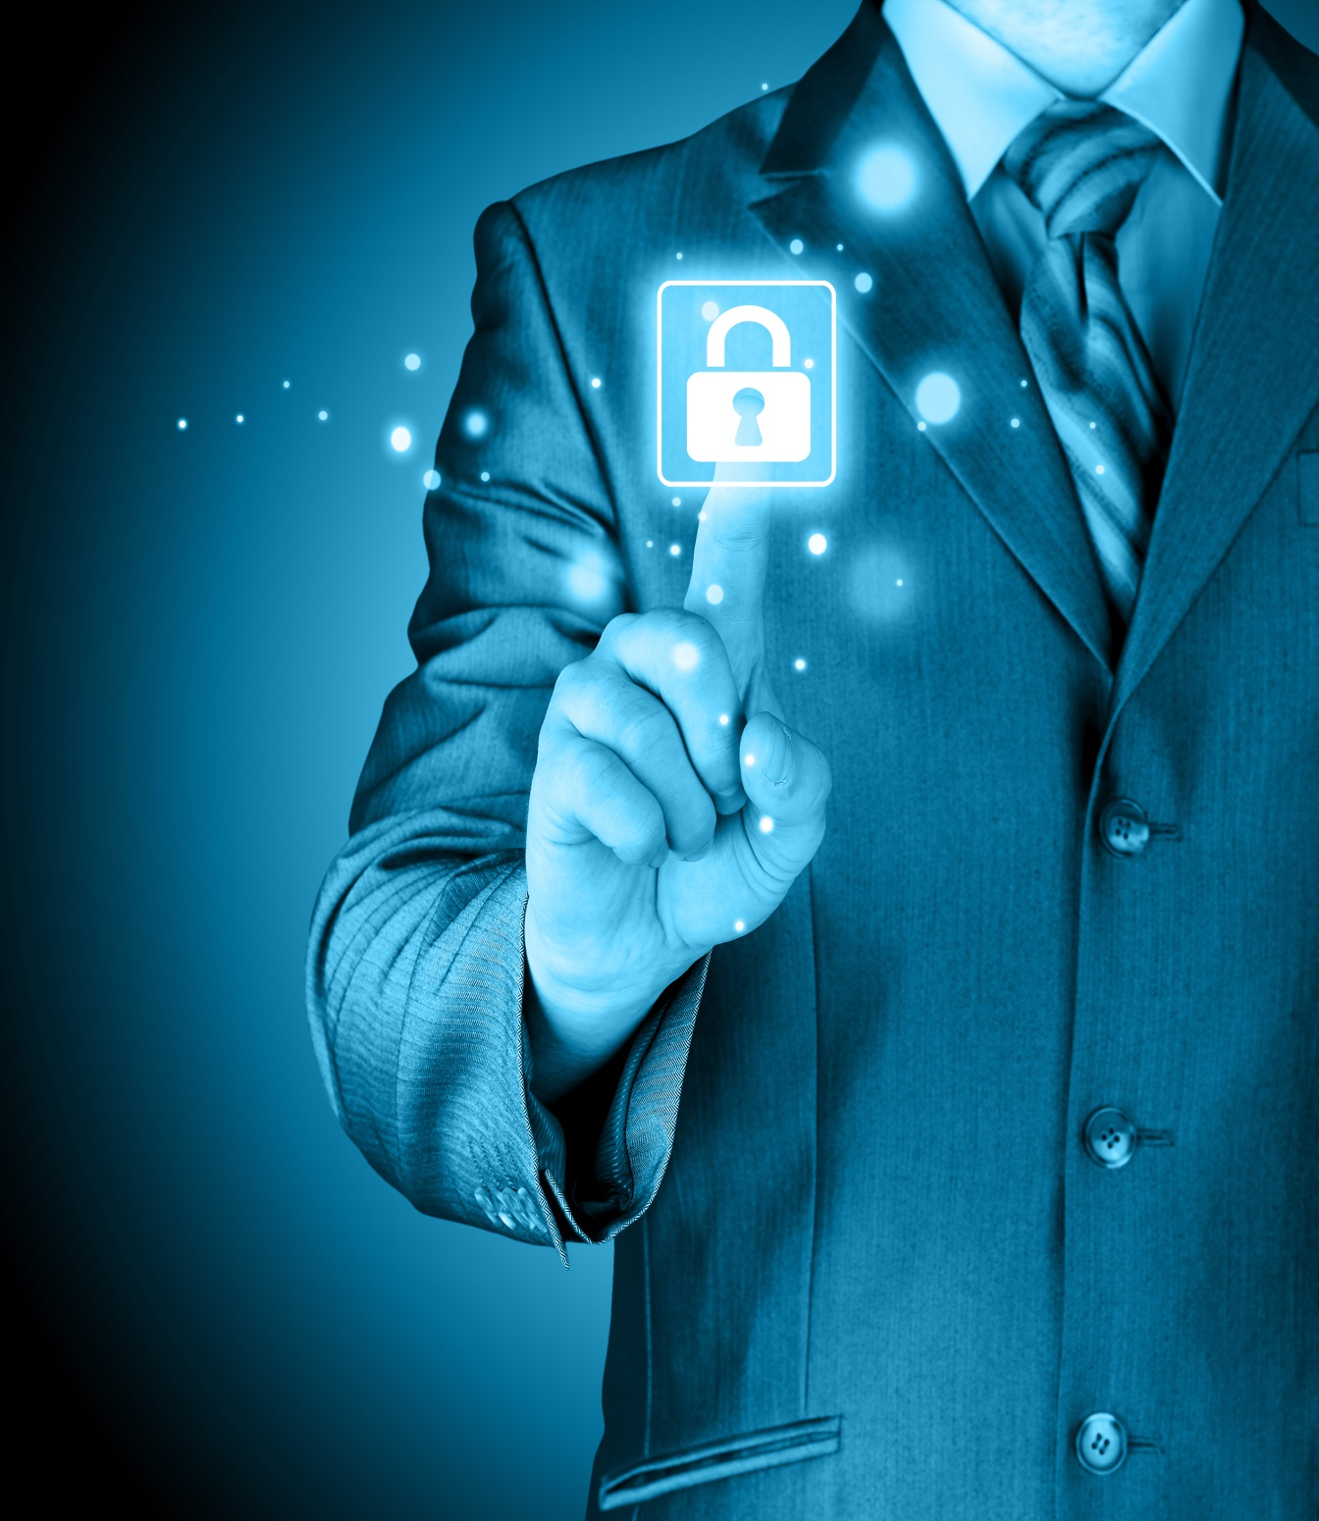

Casos Externos Recientes
http://www.informationisbeautiful.net/visualizations/worlds-biggest-data-breaches-hacks/
http://www.eltiempo.com/politica/justicia/capturan-a-9-funcionarios-de-ff-mm-y-mindefensa/16377593
http://www.eltiempo.com/tecnosfera/novedades-tecnologia/jefe-de-ashley-jefe-la-compania-dimite-tras-hackeo-masivo/16312936
http://www.elespectador.com/noticias/economia/gran-estafa-target-articulo-465190

Slide 5
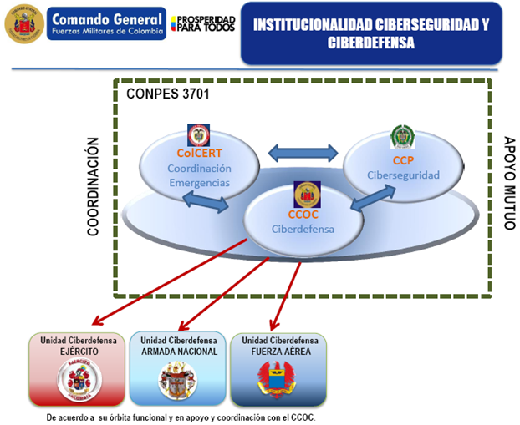
Ministerio de Defensa Nacional - Colombia
CONPES: Consejo Nacional de Política Económica y Social - Departamento Nacional de Planeación

Slide 6
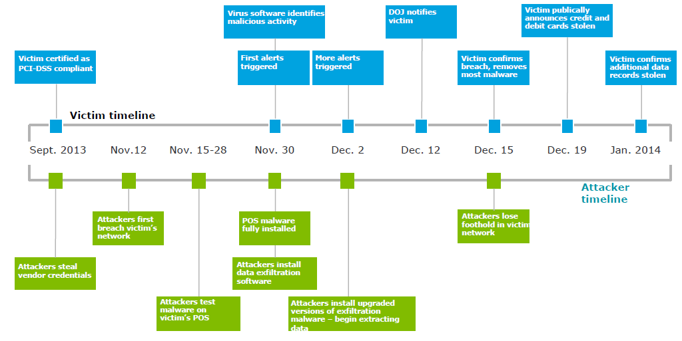
CASO TARGET
TARGET Case
Violan la red
Atacantes pierden el control
Robo de Credencial de un proveedor
Instalan el malware
Prueban el malware
Actualizan el malware
Fuente: Deloitte 2016. Cyber Risk & Information Security Study – Latinoamérica. Para más información contacte a Deloitte & Co. S.A

Slide 7
Caso Ashley Madison
Ashley Madison Case
2012: Director y fundador advierte corrían el riesgo de ser víctimas de un ataque
25 de mayo de 2015: El Director de Seguridad de Ashley Madison discutió en privado asuntos de seguridad prioritarios con el Presidente Ejecutivo
19 de Julio: Hackers revelaron detalles de dos miembros de Ashley Madison
21 de agosto 2015: El grupo (hackers) afirmó que la seguridad era “mala” y que “no había nadie vigilando”. Agregó: “Lo único que encontramos era una red segmentada. Se podía usar la contraseña ‘Pass1234’ para entrar desde Internet a la VPN y al directorio raíz de todos sus servidores.”
20 de agosto 2015: Los hackers publicaron aproximadamente 20 gigabytes de información de los clientes incluyendo correos electrónicos personales del Presidente Ejecutivo de AM
July 19: Hackers revealed details of two members of Ashley Madison
August 20: hackers published about 20 gigabytes of customer information including personal emails from the CEO of AM
August 21, 2015: Group (hackers) said security was "bad" and that "no one was watching." He added: "The only thing we found was a segmented network. You could use the password 'pass1234' to enter from the Internet to the VPN and the root directory of all servers. "
May 25, 2015: The Security Director Ashley Madison discussed in private security priority issues with the Executive Chairman
Fuente: http://www.welivesecurity.com/la-es/2015/08/31/caso-ashley-madison-cronologia/

Slide 8
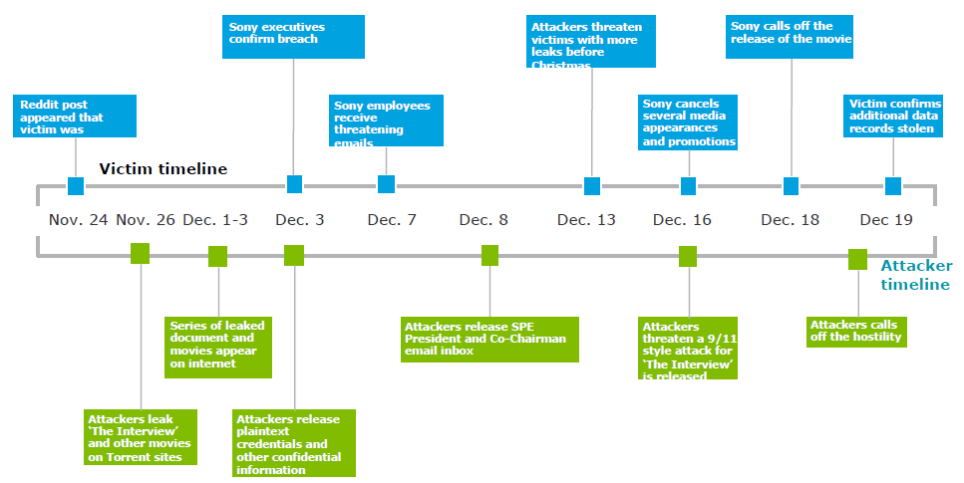
Caso SONY
SONY Case
Fuga de la película
Fuga de documentos
Fuga de correos
Fuga de credenciales
Amenazas
The Interview: Ridiculiza al líder de Corea del Norte Kim Jong-un
Fuente: Deloitte 2016. Cyber Risk & Information Security Study

Slide 9
Algunas Estadísticas

Slide 10
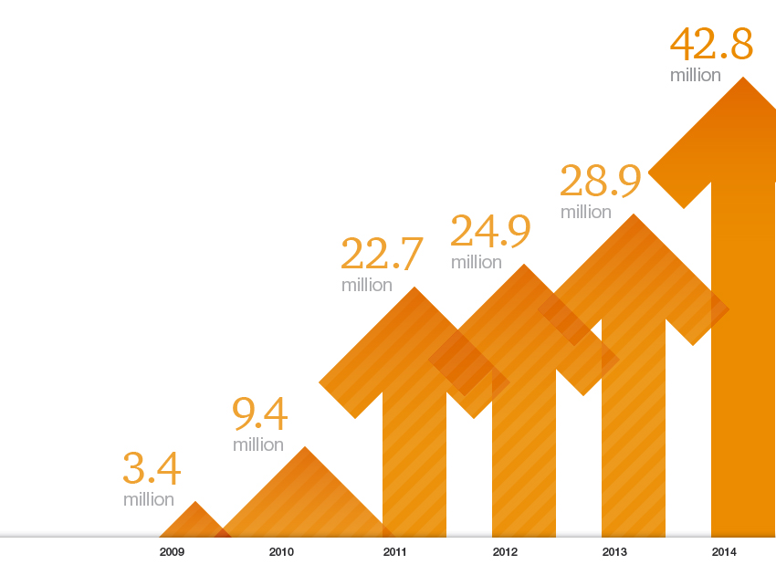
External Threats Growing
117,339 incoming attacks every day
The total number of security incidents detected by respondents climbed to 42.8 million this year, an increase of 48% over 2013.
TLP WHITE

Slide 11
Evolution of Cyber Attacks
Cyber Threats on the Private Sector
Fun
Fame
Fortune
Technically adept groups leaving their mark on public websites
Cyber criminals and organized gangs stealing money, data ransom schemes and competitive information
Force
Nation states and non-nation state groups launching targeted attacks for strategic purposes
Technically curious individuals
2001
2010
1988
2004
Academic
“Script Kiddies”
Nature of Threat
Commodity Threats
Advanced Persistent Threats (APT) – Targeting government entities
APT– Targeting private sector
TLP WHITE

Slide 12
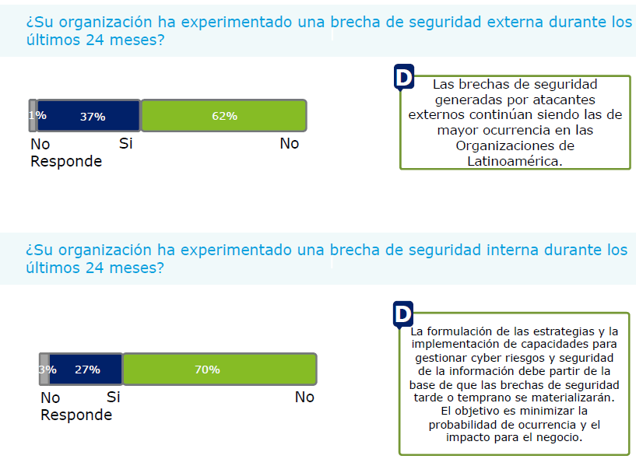
Security breaches generated by external threats are the highest occurrence in Latin America organizations
Fuente: Encuesta de Ciberseguridad 2016- Deloitte

Slide 13
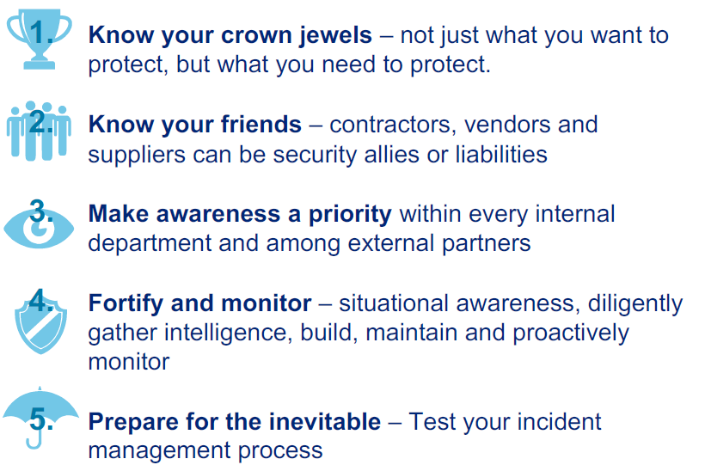
Encueta Deloitte: Consideraciones Finales
Deloitte Cibersecutiry Survery: Finals Considetations
Conoce tus joyas de la corona…
Conoce a tus amigos…
Convierte la concientización en prioridad…
Fortalecer y monitorear…
Prepárate para lo inevitable…
Fuente: Encuesta de Ciberseguridad 2016 - Deloitte

Slide 14
CIBER-SEGURIDAD – DEFINICIÓN PARA DECEVAL
CYBER SECURITY - DEFINITION FOR DECEVAL
Observamos que la seguridad de la información en el enfoque tradicional tiene un alcance mayor que la ciberseguridad: (Information security has wider scope that cybersecurity)
La Seguridad de la Información busca proteger la información de riesgos que puedan afectarla en sus diferentes formas y estados (conocimiento, documentos físicos y entornos cibernético)
Ciberseguridad: tiene como foco principalmente la protección de la información que existe en los sistemas interconectados (entorno cibernético).
The Information Security: seeks to protect information that may affect risk in its different forms and states (knowledge, physical documents and cyber environments)
Cybersecurity: its focus the protection of information that exists in the interconnected systems (cyber environment).
Ciber-Seguridad:
Información que es procesada, almacenada y transportada por los sistemas de información que se encuentran interconectados” (ISACA). Convirtiéndose en un subconjunto de la Seguridad de la Información.
SI
Ciber-Seguridad
Documentos Físicos
Entorno Cibernético
Cyber Security: Information is processed, stored and transported by information systems that are interconnected "(ISACA). Becoming a subset of Information Security.
Conocimiento Personas

Slide 15
PREGUNTAS / QUESTIONS
Sesión 1: Riesgo de Cibersegurdad
¿Dentro de los riesgos emergentes, consideran el ciber-riesgo como un riesgo estratégico?
¿Within emerging risks, do you consider cyber risk as a strategic risk?
¿Se podría decir que el riesgo cibernético puede requerir una atención especial? Por qué?
¿You could say that cyber risk might require special attention? Why?
¿Casos de estudio: Conocen ejemplos recientes? Podrían explicar el vector de ataque utilizado?
Case Study: Do you know recent examples? Are you able to explain the attack vector (means) used?
Ciber-seguridad Vs Seguridad de la Información: Cuál es su punto de vista?
Cyber security versus Information security: What is your point of view?

Slide 16
SESIÓN 2
Sesión 2: Prácticas líderes internacionales
−Presentación Implementación de ISO 27001:
Beneficios de tener la certificación
Proceso para obtenerla y mantenerla
Presentación avance en la implementación de prácticas recomendadas en la Guía de Ciber-resiliencia de IOSCO (Junio 2016)
Presentación implementación de ciber riesgo
Session 2: International Best Practices
- Presentation on the implementation of ISO 27001
• Benefits of certification
• Process to obtain and maintain
- Presentation on progress in implementing the recommended practices
in the IOSCO Cyber-resilience Guide (June 2016)
- Presentation on the implementation of cyber risk

Slide 17
Proceso de Certificación
Certification Process
Follow-up
Action plans
Verification
Certification
Audit
Internal Audit
Management Review
Pre-Audit
Closing Gaps
month 1 – month 2
month 3
month4
month 6
Month 1 year2
Relevant steps:
Definición del alcance del SGSI (Defining scope of ISMS)
Definición del alcance de la auditoría de certificación (Defining scope of the certification audit)
Elaboración de la declaración de aplicabilidad (Elaboration of the statement of applicability)
Auditorias Internas del SGSI (Internal audits of the ISMS)
Capacitaciones Auditores (Auditors training)
Revisión Gerencial (Management review)

Slide 18

Certificación ISO 27001
Principales beneficios de la certificación:
Fortalecer confianza del mercado en el manejo de la información
custodiada por DECEVAL
Mitigar riegos de ciber-seguridad
Crecientes riesgos de ataques cibernéticos contra el sistema financiero, cada vez más frecuentes, más sofisticado y más extendidos.
Documento Cyber resilience in financial market infrastructures* IOSCO - Noviembre 2014
Cumplimiento regulatorio - Normas en desarrollo (Nuevos Negocios)
Factura Electrónica (Proyecto de Decreto - Ministerio de Comercio, Industria y Turismo)
Factura Electrónica (Proyecto de Decreto - Ministerio de Hacienda y Crédito Público)
Criterios específicos de acreditación de entidades de certificación digital – ONAC
Normas para Seguridad de la Información que referencian textualmente la norma ISO 27001:
CE052/042: Criterios de Seguridad y calidad de la información
Decreto 2364 2012: Confiabilidad de la firma electrónica
* Cumplimiento con los PFMI (Principles for Financial Market Infrastructures), desarrollado por el CPMI (Committee on Payments and Market Infrastructures) y el Comité Técnico de IOSCO (International Organization of Securities Commissions)

Slide 19
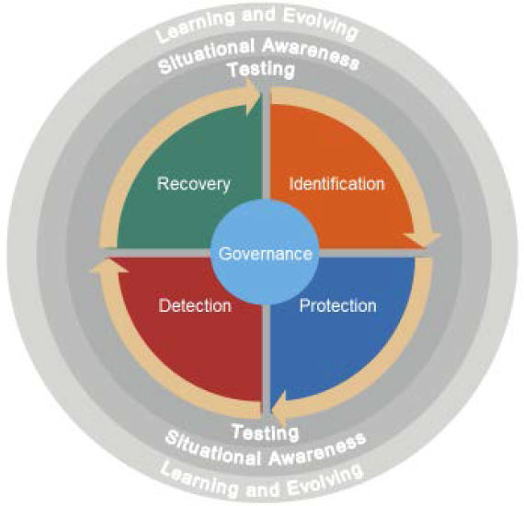
CYBER RISKS: Guidance on Cyber Resilience for Financial Market Infrastructures - IOSCO:
Learning and Evolving: Culture of cyber risk awareness whereby its resilience posture, at every level, is regularly and frequently re-evaluated.
Situational awareness: understanding of the cyber threat within which it operates, and the implications of being in that environment for its business and the adequacy of its cyber risk mitigation measures.
Testing: All elements of a cyber resilience framework should be rigorously tested to determine their overall effectiveness before being deployed within an FMI, and regularly thereafter.
Identification: Identify which of their critical operations and supporting information assets should, in order of priority, be protected against compromise.
Governance: Cyber governance refers to the arrangements an company has put in place to establish, implement and review its approach to managing cyber risks.
Protection: Cyber resilience depends on effective security controls and system and process design that protect the confidentiality, integrity and availability of an FMI’s assets and services.
Detection: Ability to recognise signs of a potential cyber incident, or detect that an actual breach has taken place
Recovery : Ability to resume critical operations rapidly, safely and with accurate data in order to mitigate the potentially systemic risks of failure to meet such obligations when participants are expecting it to meet them.

Slide 20
DECEVAL Self Assessment: Alignment with Guidance on Cyber Resilience for Financial Market Infrastructures:
Guide Cyber –Resilience IOSCO | Main Implementations -- Deceval
Governance | Policy Information Security, Cybersecurity Standards, Integrated Risk Manual, Cyber Security Guide, Audit and Risk Committee , Internal Risk Committee, Management reviews, Roles and responsibilities
Identification | Crisis and Business Continuity Management , Cybersecurity Standards, Asset Classification, Information Risk Management
Protection | Cybersecurity Risk Management, Cybersecurity Standards, Cybersecurity By Configuration Item Tools: Fiwall, IPS, ePo, DLP, Policy Auditor
Detection | Incident Management Process, Information Security Monitoring, Manual of monitoring platform on Core applications, Analytical Risk Model Tools: QRadar, Imperva, DLP
Response and Recovery | Crisis and Business Continuity Management , Cybersecurity Standards, Cybersecurity Risk Management, Backups, Alternant Data Center, High Availability
Testing | Periodical Testing, Ethical hacking, Evaluation and Testing of Business Continuity Program
Situational awareness | Cybersecurity Risk Management for Stock Market, Crisis Management for Stock Market
Learning and evolving | Frameworks: ISO 27001, ISO 22301, ISO 31000, COBIT, IOSCO, Sensitization: Managing passwords, Cybersecurity training processes, Training about specialized tools

Slide 21

CYBER – RESILIENCE GUIDE – IOSCO - PWC
General fulfillment level:
Deceval in its commitment with information’s confidentiality, integrity and availability assurance, and in accordance with its business process, meets the IOSCO Cyber-Resilience guide requirements for response and recovery in spite of cyber security incidents.
IOSCO Chapter | Score
Governance | 5
Identification | 5
Protection | 5
Detection | 5
Response and recovery | 4,7
Testing | 5
Understanding | 4,5
Learning and evolution | 5

Slide 22
CYBER – RESILIENCE GUIDE - IOSCO
Strenghts:
ISO 27001 Certified: Being an ISO 27001 certified Company eases and favors compliance with any other international standard as this particular certification covers extensively information security risk mitigation.
Cybersecurity risk management: A complete support in cybersecurity risk management is observed as the Company addresses other related companies within the stock market ecosystem.
Business continuity: Efforts along business continuity are evident. They show Deceval’s commitment in guaranteeing availability of information’s supporting business processes.
Full Company cooperation: Every area along the Company is involved in the incident response process and know how to report an information security incident.
Trained Personnel: A full commitment in training for cybersecurity incidents, along the whole Company, is found and embedded within security culture.

Slide 23
CYBER – RESILIENCE GUIDE - IOSCO
Opportunity for improvement:
Sharing market’s therat and vulnerability information: Efforts are shown for cooperation between other companies within the bussiness market. But nevertheless, a formal joint process may be needed as to identify and mitigate threats and vulnerabilities which represent a risk for the industry.
Involve authorities in threat and vulnerability information sharing: Even though Deceval is present in cybersecurity meetings with the Ministry of Defense, it is advised to formalize partnerships with authorities for cybersecurity threat and vulnerability sharing.
Bigger SOC Scope: It is strongly advised to integrate today’s SOC service (limited to firewalls) with the correlation tool used by DECEVAL (Qradar), bringing together more visibility with more critical assets, improving threat detection and prevention capability, and applying cybersecurity intelligence procedures.

Slide 24
PRESENTACIÓN DCV CHILE
PRESENTATION DCV CHILE

Slide 25
PREGUNTAS
Sesión 2: Prácticas líderes internacionales
¿Qué mecanismos está adoptando su compañía para afrontar este riesgo?
¿What mechanisms are you adopting in your organization to confront this risk?
¿Han tenido algún acercamiento o experiencia con la norma ISO 27001: Sistema de Gestión de Seguridad de la Información. Dar detalles?
¿If you have an approach or experience in implementing ISO 27001: System for the Management of Information Security would you provide details?
¿Han avanzado en la implementación de prácticas recomendadas en la Guía de Ciber-resiliencia de IOSCO (Junio 2016)?
¿Are you making advances in the implementation of the recommendations in the IOSCO Cyber-resilience Guide (June 2016)?

Slide 26
SESIÓN 3
Sesión 3: Redes colaborativas, compartir información
Video ciberseguridad
Presentación actividades con clientes internos y externos en DECEVAL
Presentación mesa de trabajo del Ministerio de Defensa Nacional
Presentación mesa de trabajo ciber seguridad del mercadeo valores
Session 3: Collaborative networks, information sharing
- Cyber security video
- Presentation of activities with internal and external clients in DECEVAL
- Presentation of cyber security workshop of the securities market
- Presnetation of the workshop of the National Ministry of Defence

Slide 27
Actividades con clientes internos y externos en DECEVAL Activities with internal and external customers DECEVAL

Slide 28
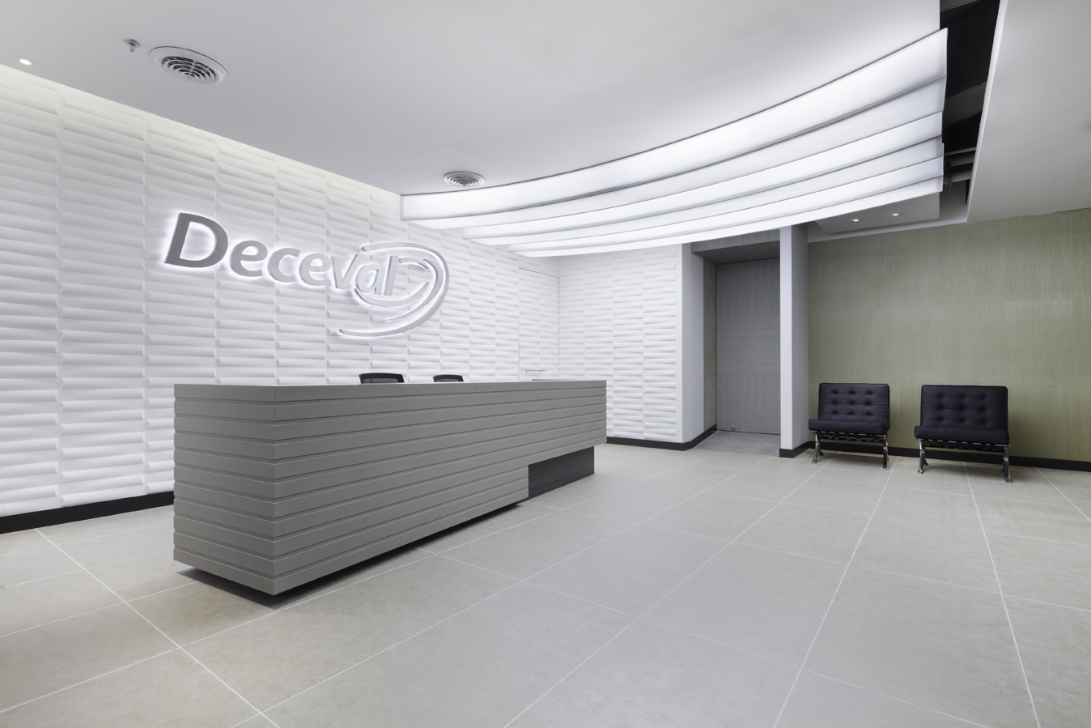

ISO 27001:2013 CERTIFICATION
Activities with internal and external users DECEVAL
2
TRAININGS FOR 50 EMPLOYEES' CHILDREN
100%
TRAINED EMPLOYEES
2
5
2
GENERAL ETHICAL HACKING:
SPECIFIC ETHICAL HACKING:
VULNERABILITY ANALYSIS:
14
AWARENESS ACTIVITIES
208
15
MONITORING ACTIVITIES
COMMITTEES (INTERNAL AND BOARD)
PEOPLE WITH ISO 27001 CERTIFICATE
9
2
EXTERNAL CONFERENCE

Slide 29
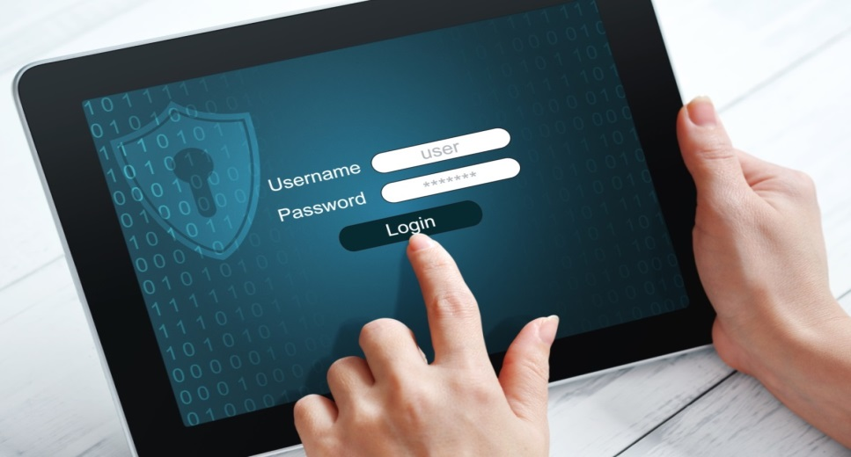
Actividades con usuarios internos y externos en DECEVAL
Activities with internal and external users DECEVAL
Principales Enfoques
Main Approaches
Manejo de contraseñas
Manejo de información personal
Capacitaciones especializadas
Medición de cumplimiento
Password management
Personal Information Management
Specialized training
Measuring compliance
Contraseñas
Taller de contraseñas seguras
Pruebas especializadas
Estadísticas mensuales
Reporte a la alta dirección
Passwords
Workshop: secure passwords Specialized tests Monthly Statistics Reporting to senior management

Slide 30
Monitoring Secure Password
Month | % Unsafe
February | 35.83%
March | 20.53%
April | 13.20%
May | 10.66%
June | 8.63%
July | 6.40%
August | 6.90%
September | 6.40%
October | 5.42%
November | 2.46%
December | 3.45%
December
November
October
September
August
July
June
May
April
March
February

Slide 31
Example Password unsafe Statistics

Slide 32
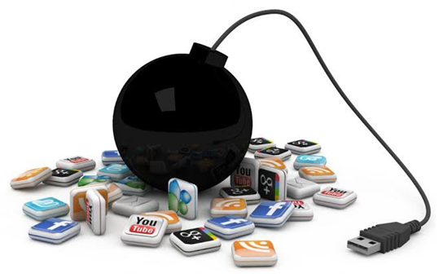
Personal Information Management
Colaboradores:
Conferencias: Manejo responsable de las TIC’s – EnTicConfío - Dijín
Campañas internas
Employees: Conference: Management responsible for ICT - EnTicConfío – Dijin internal campaigns
Hijos
Conferencias: Manejo responsable de las TIC’s – EnTicConfío
Capacitaciones: Seguridad de la Información
Children: Conference: Management responsible for technologies – EnTicConfío
Training: Information Security Measures

Slide 33
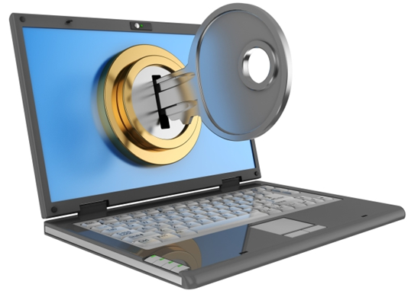
Medición de cumplimiento
Measuring compliance
Violaciones de seguridad
Asistencia a capacitaciones
Afectación a compensación variable
Security violations
Training assistance
Variable compensation affectation
Capacitaciones Especializadas
Capacitaciones a la alta dirección
Capacitaciones técnicas para administradores de TI
Capacitaciones dirigidas al personal de operación
Specialized training
Senior management training
technical training for IT managers
Training for the staff operating

Slide 34
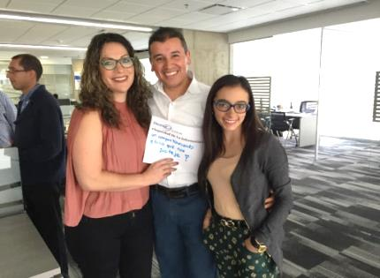
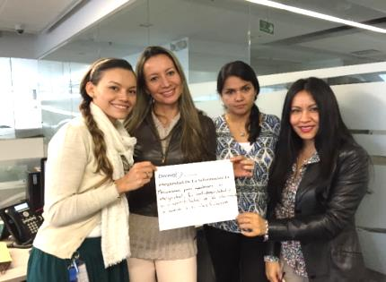
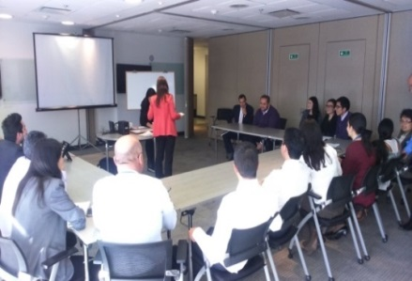
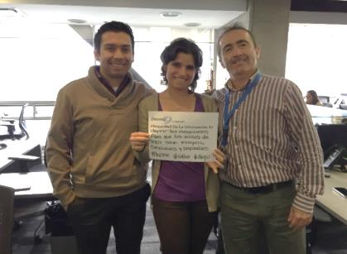
ACTIVIDADES DE CAPACITACIÓN ESPECIALIZADA DIRIGIDAS AL PERSONAL DE DECEVAL.
SPECIALIZED TRAINING ACTIVITIES AIMED TO STAFF DECEVAL.
Activos de Información (148 Empleados y Proveedores): Enfocada a todo el personal del Depósito
Information Assets (148 employees and suppliers): Focused on the staff of the Deposit
Ciberseguridad y Ciber-riesgos (24 Directivos): Dirigida la dirección del Depósito
Cybersecurity and cyber-risks (24 executives): Directed the direction of the Deposit

Slide 35
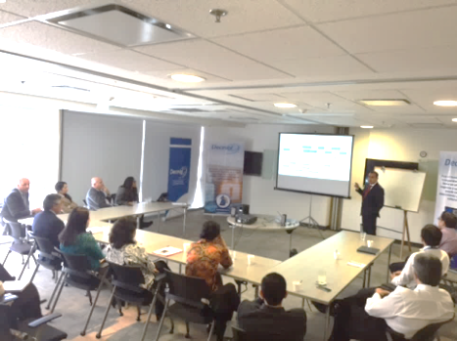
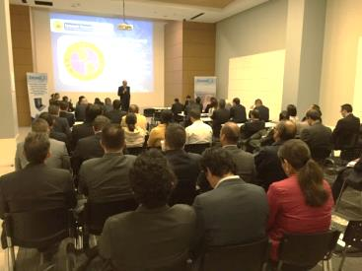
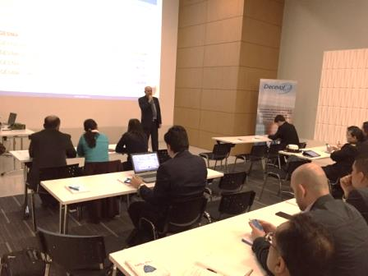
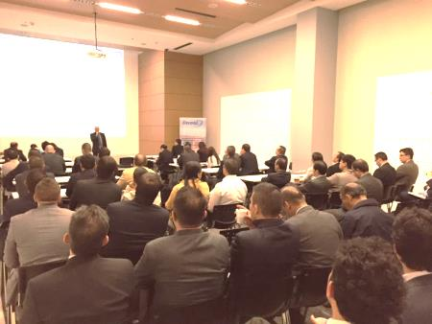
ACTIVIDADES DE CAPACITACIÓN ESPECIALIZADA DIRIGIDAS AL PERSONAL DE DECEVAL.
SPECIALIZED TRAINING ACTIVITIES AIMED TO STAFF DECEVAL.
Ciberseguridad y Ciberdefensa Ministerio de Defensa Nacional (70 personas - Aprox. 50 compañías – Dos años)
Cyber security and defense Ministry of National Defense (70 people - Approximately 50 companies -. Two years)
Ransomware: Panel con Policía Nacional, PWC y un abogado experto tecnología, para el personal del Depósito (46 Empleados)
Ransomware: Panel with National Police, and an expert lawyer PWC technology, to deposit staff (46 employees)
Blockchain: Tecnologías Emergentes: Amenazas? Oportunidades?: Tecnología, Riesgos y Jurídica (16 persoans)
Blockchain: Emerging Technologies: Threats? Opportunities ?: Technology, Risk and Legal (16 persons)

Slide 36
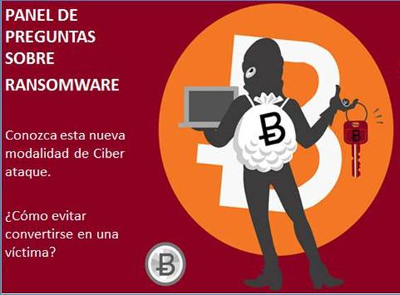
Ransomware is computer malware that installs covertly on a victim's computer, executes a cryptovirology attack that adversely affects it, and demands a ransom payment to decrypt it or not publish it. Simple ransomware may lock the system in a way which is not difficult for a knowledgeable person to reverse, and display a message requesting payment to unlock it. More advanced malware encrypts the victim's files, making them inaccessible, and demands a ransom payment to decrypt them. Wikipedia
Un ransomware (del inglés ransom, ‘rescate’, y ware, por software) es un tipo de programa informático malintencionado que restringe el acceso a determinadas partes o archivos del sistema infectado, y pide un rescate a cambio de quitar esta restricción. Algunos tipos de ransomware cifran los archivos del sistema operativo inutilizando el dispositivo y coaccionando al usuario a pagar el rescate. Wikipedia.
https://www.youtube.com/watch?v=xpFU4n2iHN8

Slide 37
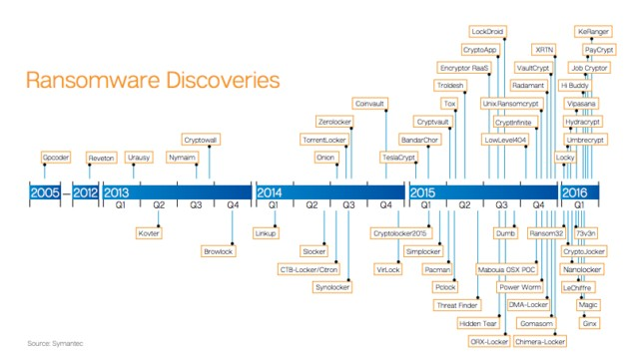
Fuente: PWC

Slide 38
Tecnologías Emergentes: Amenazas? Oportunidades? Emerging Technologies: Threats? Opportunities?
https://www.youtube.com/watch?v=ARVv_6mh6BA https://www.youtube.com/watch?v=iVKX2bbg31o

Slide 39
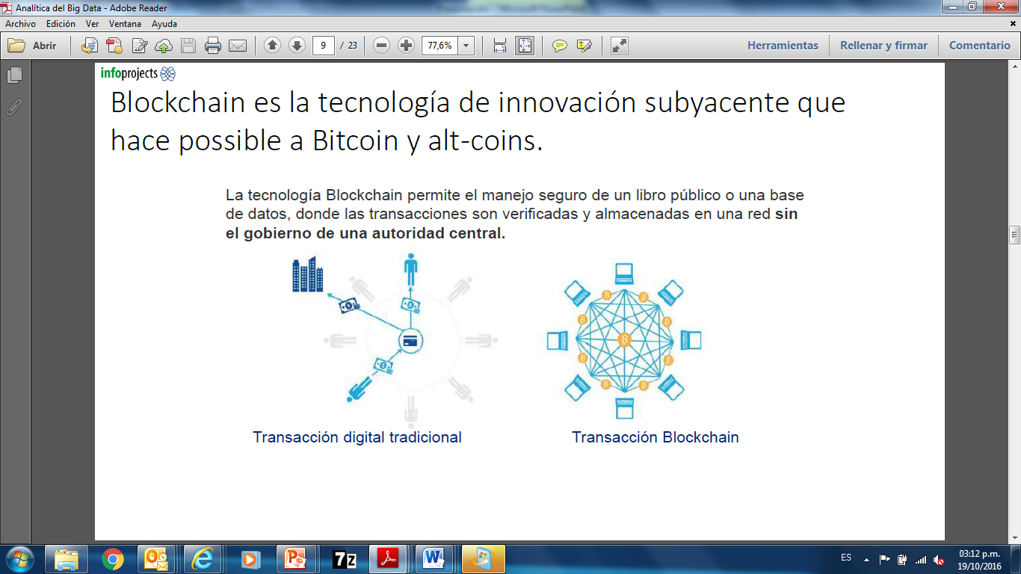
Blockchain is the underlying technology that makes possible bitcoin and alt-coins
Fuente: InfoProject Colombia – Jimmy Chung

Slide 40
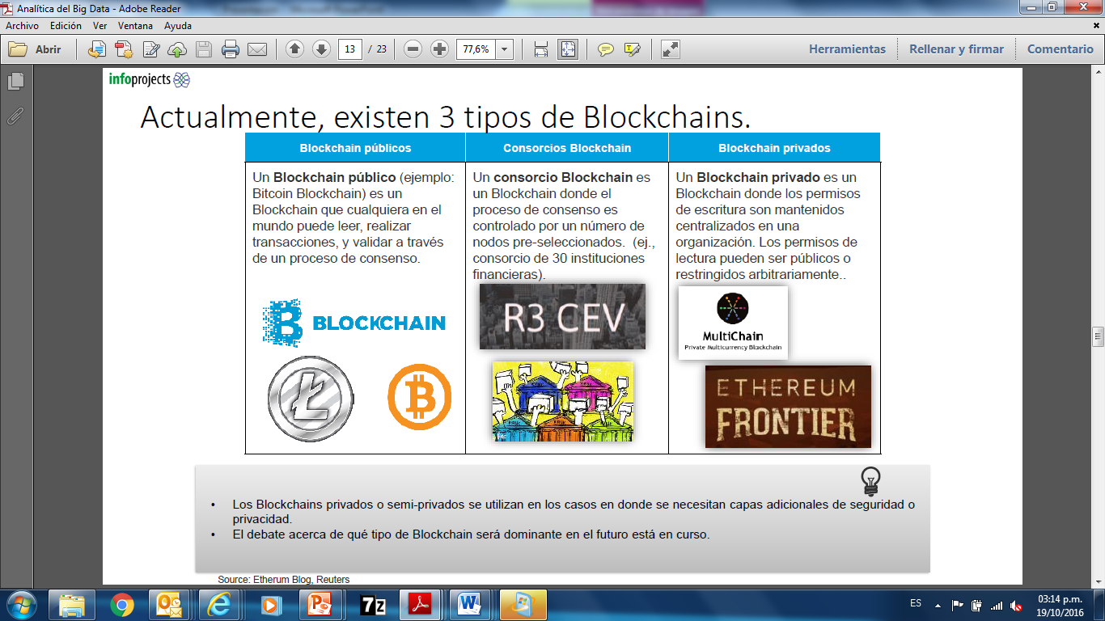
Se Están Utilizando 3 Tipos de Blockchain
They are being used 3 Types of Blockchain
A public blockchain (example: bitcoin blockchain) is a blockchain of cualqueira in the world can read and validate transactions THROUGH a consensus process
One blockchain consortium is a blockchain where the consensus process is controlled by a number of pre-selected nodes (example: Consortium 30 financial institutions)
Aprivate blockchain is a blockchain where permissions are maintained in a centralized organization read permissions can be public or restricted arbitrarily
Fuente: InfoProject Colombia – Jimmy Chung

Slide 41
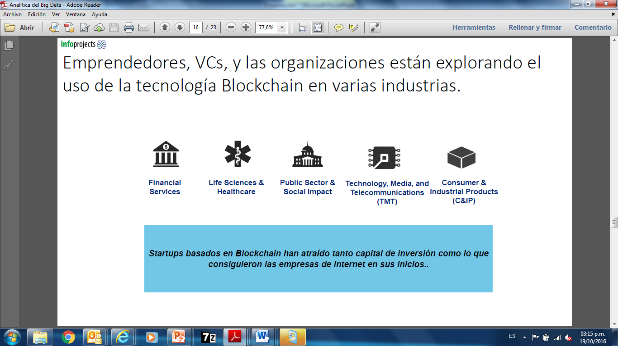
Emprendedores y organizaciones que están explorando de la tecnología Blockchain en varias Industrias.
Entrepreneurs and organizations are exploring the Blockchain technology in various industries.
Blockchain based startups have attracted much investment capital, as internet companies in its infancy
Fuente: InfoProject Colombia – Jimmy Chung

Slide 42
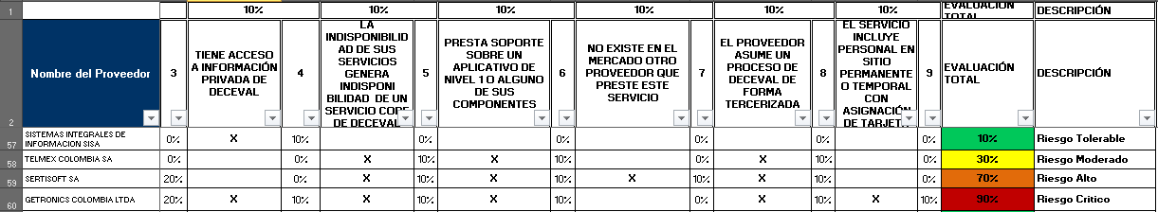
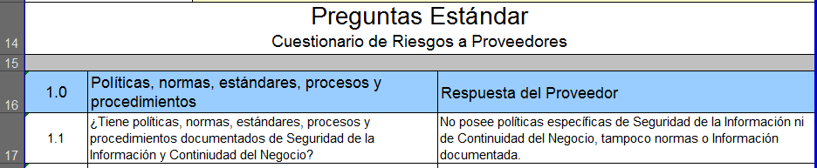
EVALUACIÓN DE NIVEL DE RIESGO DE PROVEEDORES
Fase 1: Criterios para la selección de proveedores con mayor nivel de exposición a riesgos de Seguridad de la Información, Seguridad Corporativa y Continuidad del Negocio.
Nivel de Riesgo:
Del 76% al 100%: Crítico
Del 51% al 75%: Alto
Del 26% al 50%: Moderado
Del 0% al 25%: Tolerable
Periodicidad de Visita:
Rojo: Semestral
Naranja: Anual
Amarillo: Bi-Anual
Verde: Nunca
Los rangos de priorización y la periodicidad de las visitas se explicarán en la siguiente diapositiva.
Fase 2: Preparación del cuestionario sobre Seguridad de la Información, Seguridad Corporativa y Continuidad del Negocio a Proveedores.
Fase 3: Visitas a cada uno de los proveedores con mayor exposición al riesgo de Seguridad de la Información, Seguridad Corporativa y Continuidad del Negocio
Coordinar
Coordinación con el líder del contrato ly el proveedor la auditoría.
Ejecución
Informar
Informar sobre auditoría e invitar a las áreas involucradas.
Notificar / Invitar
Visita al proveedor y aplicación del cuestionario de Riesgo.
Presentación a Comité de riesgos
Consolidación y divulgación de resultados con áreas Involucradas.
Exposición de resultados y toma de decisiones.

Slide 43
Mesa de Trabajo del Ministerio de Defensa Nacional Bureau of the Ministry of National Defense

Slide 44

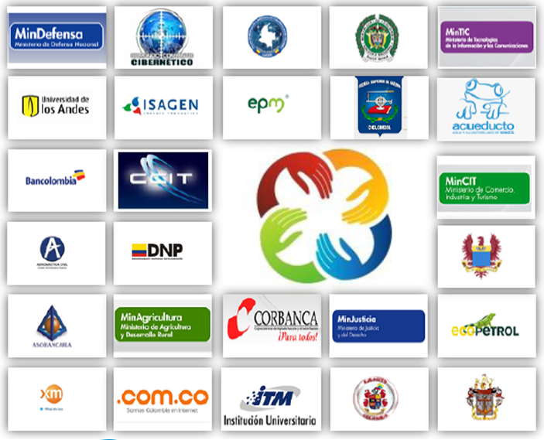






MESA DE TRABAJO DE INFRAESTRUCTURAS CRÍTICAS, CIBERSEGURIDAD Y CIBERDEFENSA
WORKBENCH CRITICAL INFRASTRUCTURE, cyber security and defense
Principales Empresas Participantes
(Major Participating Companies)

Slide 45
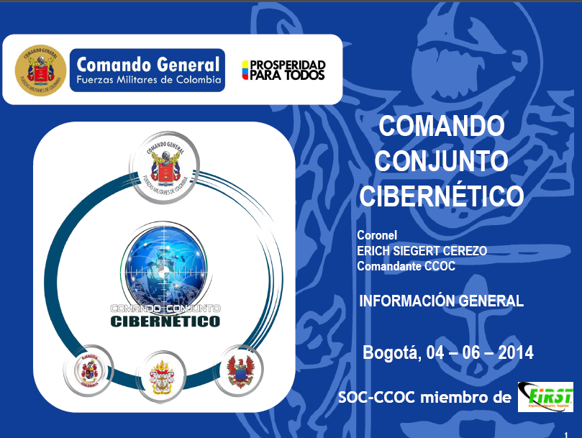
MESA DE TRABAJO DE INFRAESTRUCTURAS CRÍTICAS, CIBERSEGURIDAD Y CIBERDEFENSA
Principales Ventajas de participar:
Aporte a una iniciativa para la seguridad del país
Visibilidad del Depósito a nivel nación
Posicionamiento de Deceval como proveedor de infraestructura comprometido con la gestión integral del riesgo en Colombia
Posicionamiento frente gerentes y directores de seguridad y continuidad en el sector
Relacionamiento con agencias de ciberseguridad del estado
Construcción de redes colaborativas con otras empresas del sector
Como resultado del trabajo realizado por este grupo, el Ministerio de Defensa pretende definir y promover :
Estrategia Nacional de Ciberseguridad y Ciberdefensa
Doctrina en Ciberdefensa
Catálogo de infraestructuras críticas de Colombia
Iniciativa de ley en Ciberdefensa y Ciberseguridad
Objetivos de trabajo:
Definición de Guías de Aplicación para las infraestructuras críticas, orientadas a garantizar la disponibilidad de los servicios esenciales frente a amenazas cibernéticas, en términos de:
Gestión de Riesgo
Gestión de Continuidad
Gestion de Activos
Gestión de Incidentes
Gestión de Vulnerabilidades

Slide 46
Mesa de Trabajo - Ciber-Seguridad Mercado de Valores Working table - Cybersecurity Market

Slide 47






CRONOGRAMA Y ACTIVIDADES
(TIMELINE AND ACTIVITIES)
TEMA | FECHA
1. Cyber Crime: Principal Risk Industry
Risk Management Cyber Security | Semestre I 2016
Recent case study
2. Recognition of common practices and shared services proposals
Technology | Semestre II 2016
SOC
Ethical hacking
Vulnerability scan
Processes | 2017
Understanding and Implementation Guide IOSCO -Ciber - Resilience Financial Market Infrastructure and Cyber Security Guidelines NYSE)
Incident Management: NIST 800-61, ISO 27035
People | 2017
Awareness and Training
Performance measurement
3. Development of guidelines and collaborative tools
Analysis methodology and ISO 27001 certification requirements | 2017
Continuous monitoring: Implementation of automated tools
ACTUAL

Slide 48
CYBER SECURITY RISK MANAGEMENT
Cybersecurity RISK: LOSS OF CONFIDENTIALITY, INTEGRITY AND AVAILABILITY OF THE INFORMATION, through mechanisms as social engineering, hacking tools, physical damage and MALWARE
ACTORES / MOTIVACIONES
MECANISMOS
VULNERABILIDADES
IMPACTO
HACKTIVISM
ESPIONAGE
WAR
DELINQUENCY
Attackers:
Society
Employees
Competition
customers
governments
providers
SOCIAL ENGINEERING
HACKING TOOLS
PHYSICAL DAMAGE
MALWARE
TECHNOLOGY
SUPPLIERS CRITICS
PROCESSES
PHYSICAL FACILITIES
GOVERNMENT INFORMATION SECURITY
CONFIDENTIALITY
UNAUTHORIZED DISCLOSURE OF INFORMATION
INTEGRITY
CORRUPTION AND DATA SYSTEMS
AVAILABILITY
UNAVAILABILITY OF SERVICES
MARKET IMPLICATIONS: systemic risk, impairment of reputation, loss of credibility in the market, credit and liquidity effects not have certainty about the rights of investors or financial position, economic risk for the country, demands, penalties, fines, financial losses

Slide 49
CYBER SECURITY RISK LEVEL
Conf
Disp + Int
3
3
3
3
42 Controles
Método Delphi (33 Causas) - Impacto (Reputaciones, financiero y legal)
Conclusiones
El nivel de riesgo de ciber-seguridad general para el mercado está dado por el nivel riesgo de la compañía más expuesta.
Las principales causas de tener distintos niveles de riesgo de ciber - seguridad en las compañías está dada por la falta de controles tecnológicos, de proceso y de personas.
La meta propuesta (2017) es mover las tres compañías con más baja calificación, al siguiente nivel.
Se están generando planes de acción compartidos para lograr homologar este nivel, orientados a compartir conocimiento, prácticas y servicios.
Conclusions
The level of cyber security risk for the market overall is given by the risk level of the most exposed company
The main causes of having different levels of cyber - security risk is given by the lack of controls (technology, process and people controls)
The goal (2017) is move the three companies with lower grade to the next level
We are generating shared action to standardize this level, aimed at sharing knowledge, practices and services.

Slide 50
PREGUNTAS
Sesión 3: Redes colaborativas, compartir información
¿Su compañía ha realizado algún trabajo de manejo de ciber-riesgos de forma directa con los clientes?
¿Has your company done any work in cyber-risk management directly with customers?
¿Su compañía ha trabaja en alianza con otros actores del mercado?
¿Is your company working in partnership with other market players?
¿Su compañía ha trabaja en alianza con el gobierno para el manejo del ciber-riegos?
¿Is your company working in partnership with the government in the management of cyber risk?

Slide 51
SESIÓN 4
Conclusiones día 2
Selección de un voluntario para moderar la sesión de conclusiones
Compartir los principales aspectos de aprendizaje del día para cada uno de los participantes
Lectura final de las conclusiones.
Conclusions Day 2
- Selection of a volunteer to moderate the session of conclusions
- Share the principal aspects of learning from day one from each of the participants
- Final summary of the conclusions

